Slide 1

TALENT SEARCH (JOB PORTAL)
ITW –2 PROJECT

Slide 2


TEAM MATES:
NEERUDU NIKHIL
(21075059 , SOPHOMORE FROM C.S.E, IIT BHU)
GUNDLAKUNTA UNUREDDY
(21075035, SOPHOMORE FROM C.S.E, IIT BHU)

Slide 3

FEATURES OF WEBSITE(TALENT SEARCH)
HOMEPAGE
USER LOGIN
COMPANY LOGIN
APPLYING FOR A JOB
POSTING A JOB
ACCEPTING/REJECTING AN APPLICANT

Slide 4
FEATURES FOR USER
1.User can check the available jobs
2. They can apply for the job, they are interested in.
3.They can check whenever a new job is posted.
4.They can check the detailed description of the available jobs.
5.They will get a notification from the applied company about their application status.

Slide 5
FEATURES FOR COMPANY
1.They can add the jobs.
2.Companies have privilege to edit their jobs.
3.They can check the applicants whoever applied to their company along with their resume.
4.They have full control to select or reject a particular applicant.
5.Moreover they can add the start and end date for applying to a certain job in their company.

Slide 6
FEATURES FOR ADMIN
1.Admin have all the rights to delete an applicant.
2.Admins should accept the company before they can post the jobs in the website.
3.Admin have all the privileges to reject a company if the verification has gone wrong.
4.Admin can edit the status of the company at any time.

Slide 7
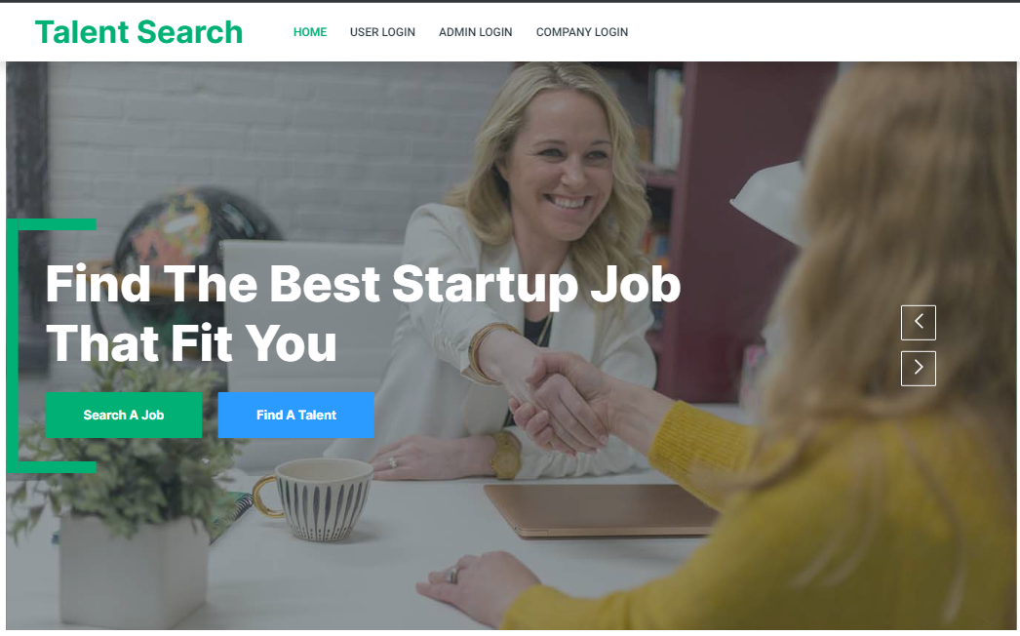
HOME PAGE

Slide 8
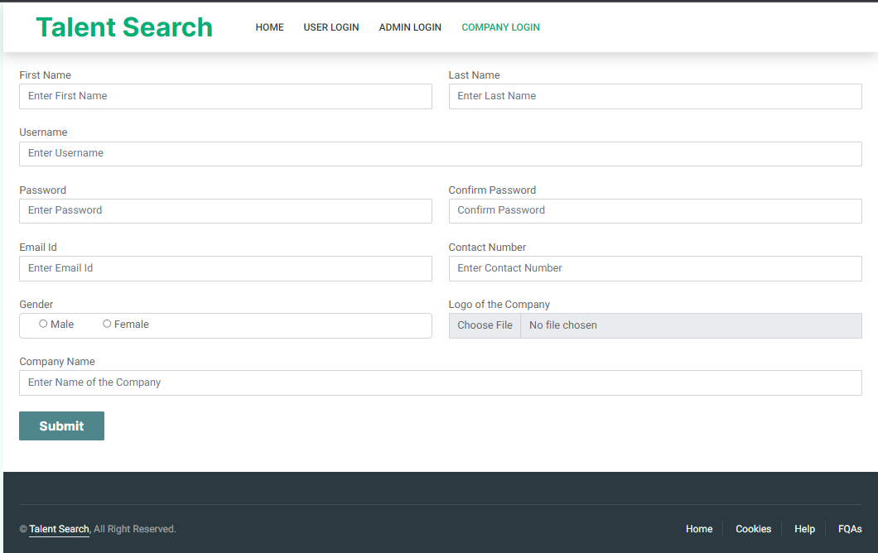
SIGNUP PAGE

Slide 9
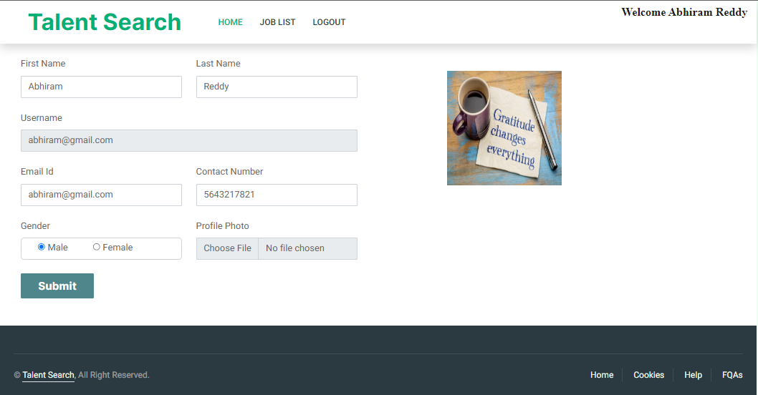
USER HOME PAGE

Slide 10
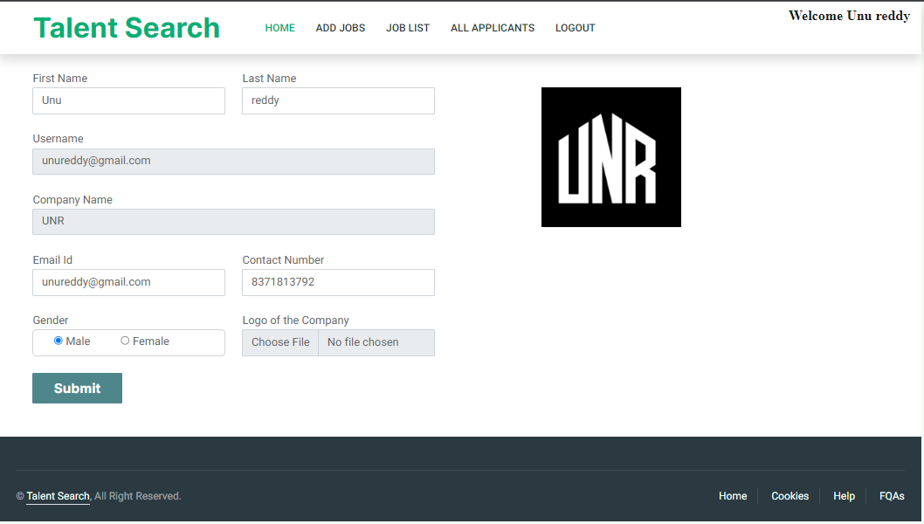
COMPANY HOME PAGE

Slide 11
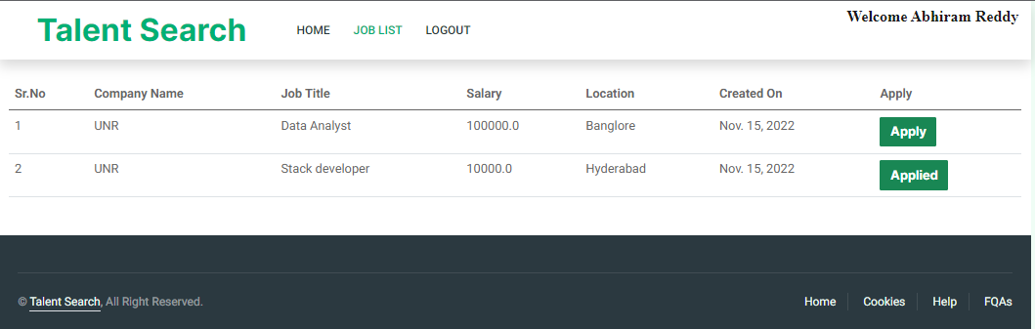
USER JOB LIST

Slide 12
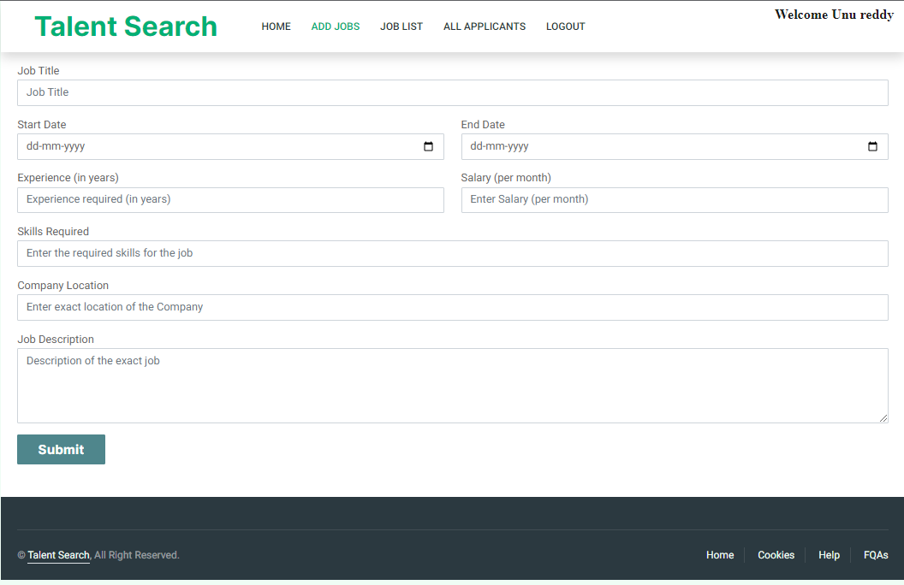
PAGE FOR ADDING JOBS BY COMPANY

Slide 13
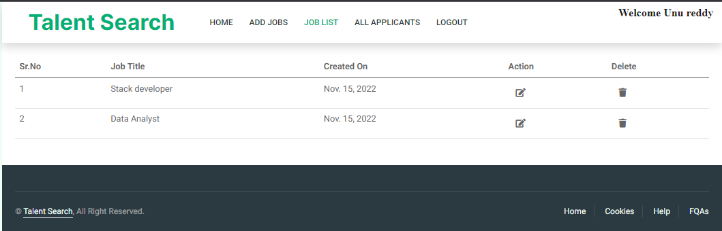
JOBS OFFERED BY A COMPANY

Slide 14
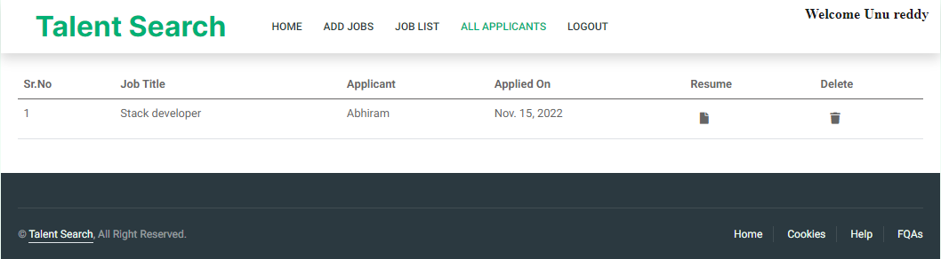
APPLICANTS APPLIED FOR A COMPANY

Slide 15
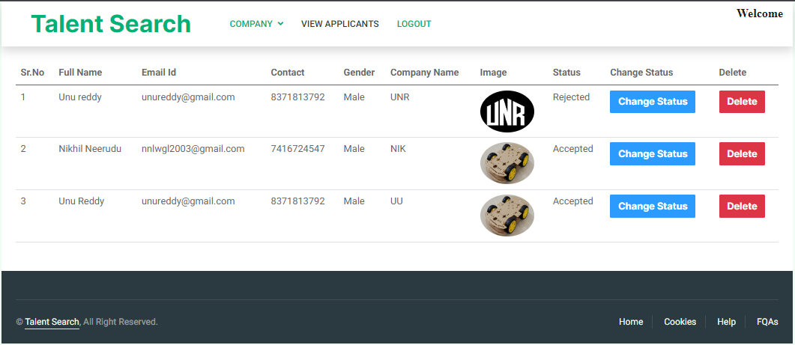
ADMIN INTERFACE FOR ALL COMPANIES

Slide 16
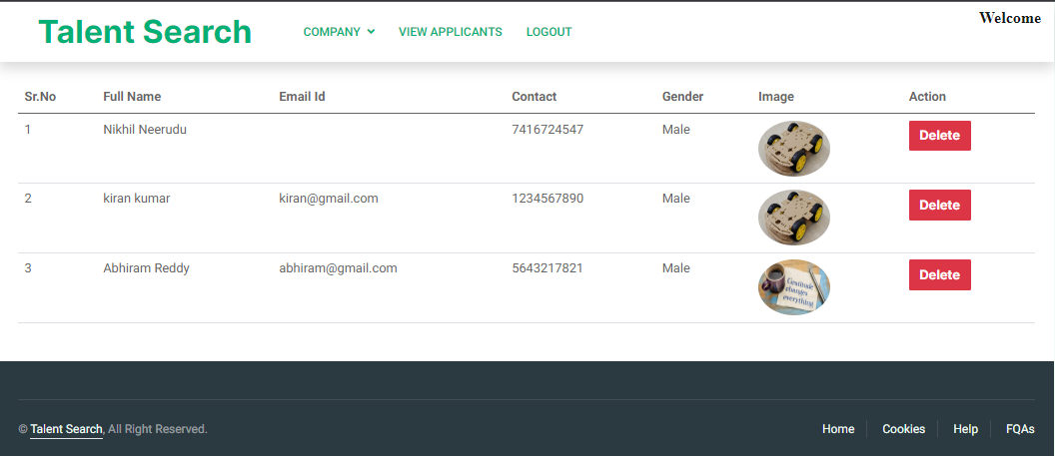
ADMIN INTERFACE FOR ALL APPLICANTS

Slide 17

WE PROVIDE YOU A BETTER INTERFACE FOR FINDING THE BEST JOB THAT FITS YOU.
- TALENT SEARCH.

Slide 18



Summary
Basically, we have prepared a web application that can help users from various industries to look for a job which suits them the best , in the similar way we have added an interface to the companies who are recruiting the staff in their esteemed companies. So, this will help in two ways for both the users who are looking for a job and for the companies who are recruiting the staff members.

Slide 19

Thank you
-GUNDLAKUNTA UNUREDDY (21075035)
-NEERUDU NIKHIL (21075059)

